Slide 1
Image Super Resolution using GANs
Cognitive Computing
Trupti Gore

Slide 2
What is our USP ?
After studying a lot of research papers to understand Image Super resolution, we saw most models trained on CNN, Deep Recursive CNN, End to End Shallow Net. I found a paper with mention of GAN but work in progress for it. This caught my interest and with help from reference material, I have built a Image Super Resolution Model in GAN set-up.

Slide 3
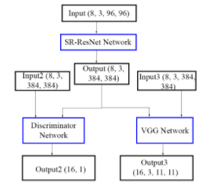
Structure of our Model

Slide 4
Datasets
Coco – Train 2014 – 80000+ complex images (Train)
Set 5 – 5 Images (Benchmarking)
Set 14 – 14 Images (Benchmarking)
BSD100 – 100 Images varied (Benchmarking)

Slide 5
Benchmark
Compile
& Train
Pre-train
Components

Slide 6
Components
VGG-16 + Super Resolution → Pretrain
Generator + Discriminator → Pretrain
Compile = (VGG-16 + Super Resolution )+ (Generator + Discriminato) → Full Train
Benchmarking

Slide 7
Pre-train
I have used VGG-16 net and added regularizers to stabilize our model – ContentVGG and Total Variation VGG regularizer
Pre-train 1 : VGG + SR → only VGG losses used for training – Regularizers
Pre-train 2 : Discriminator + Generator – Binary Crossentropy loss is used for train Discriminator net

Slide 8



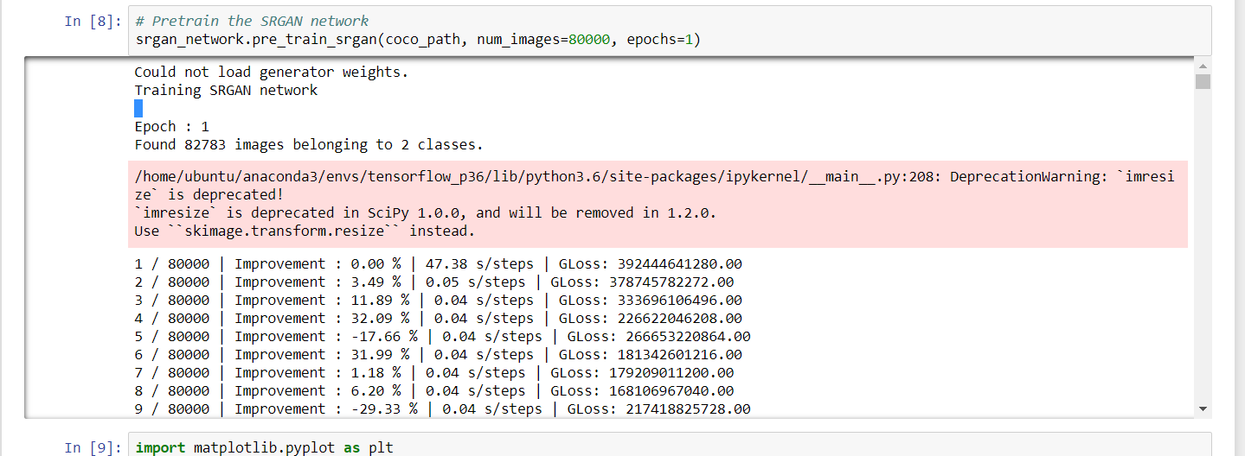


Compile & Train
Net is assembled- VGG+ SR + GAN

Slide 9
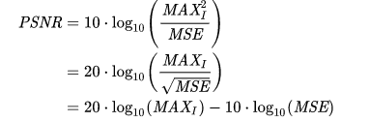
Benchmarking
The PSNR for the three datasets used for bench marking is as follows :
PSNR is performance metric, Peak Signal to Noise Ratio
Dataset | PSNR
set14 | 20.64
set5 | 19.93
bsd100 | 20.21

Slide 10
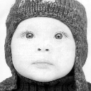
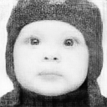
Generated Images
Real | Generated

Slide 11
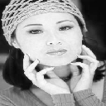


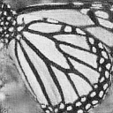
Real | Generated

Slide 12
Thank you

